Slide 1
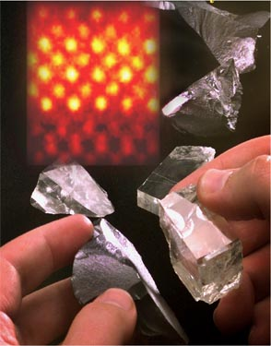
Materials Science and Engineering Interdisciplinary with HUGE potential
Christine Broadbridge, Ph. D.
Center for Research on Interface Structures and Phenomena an NSF-funded Materials Research Science & Engineering Center (MRSEC)
Yale University • Southern CT State University
Materials and Manufacturing Teacher Institute 2017

Slide 2
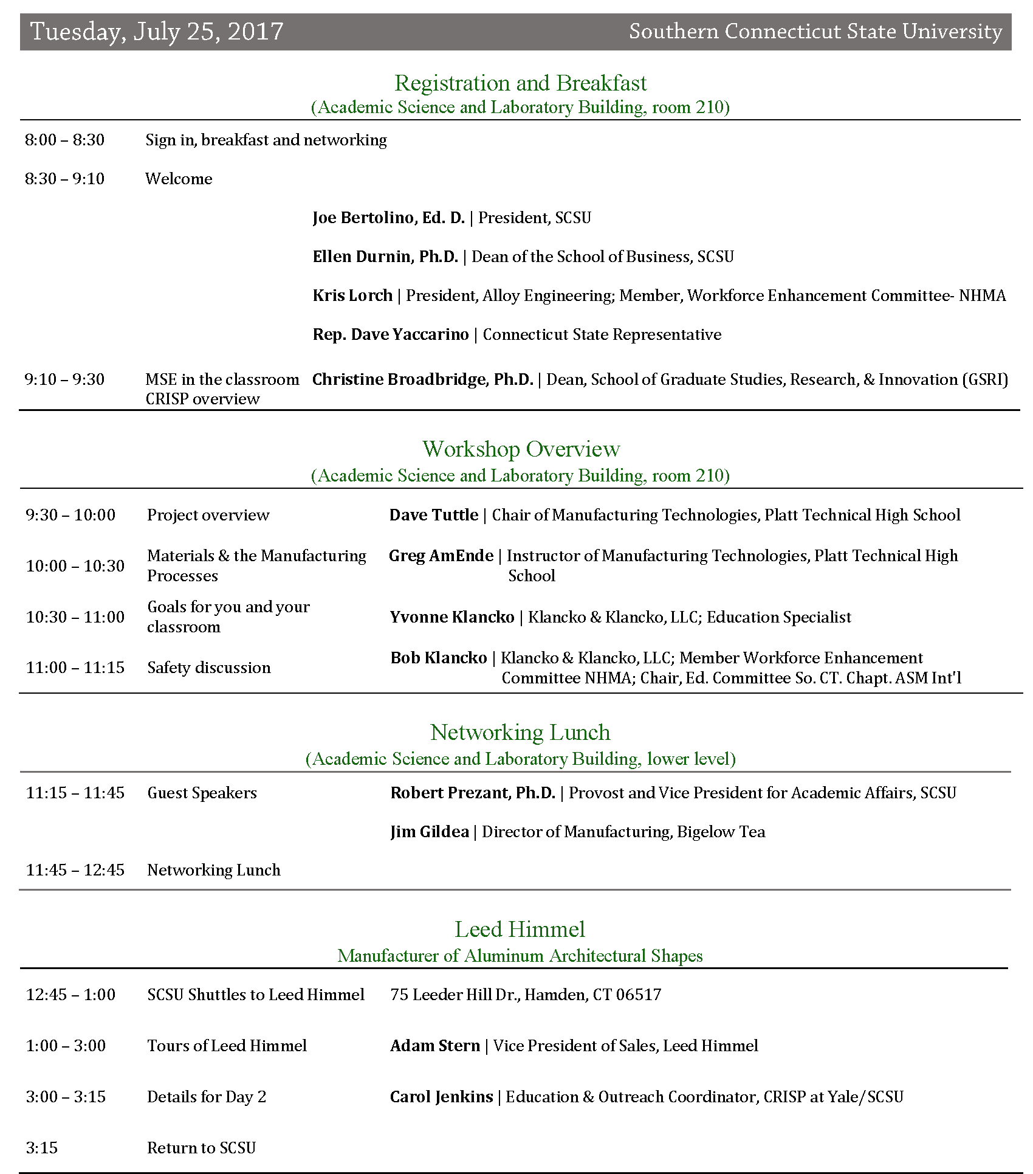

Slide 3
Resources for Educators crisp.southernct.edu
March 4, 2017
Professional Development | For educators, professionals, and practicing scientists
Educational Resources | Clearing-house for hands-on activities and demos available for loan for local educators
Past workshops | View materials from past workshops, videos, and pictures
Library | CRISP has a collection of books and DVDs also available
Courses at SCSU | See what graduate courses Southern has to offer in the Applied Physics program!
SCSU Office for STEM Innovation and Leadership (STEM-IL)
https://www.southernct.edu/stem/about-us.html

Slide 4
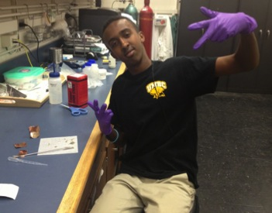
Introduction
What is materials science*?
A branch of science that focuses on materials; interdisciplinary field impacting the physical, life & engineering sciences.
Relationship of material properties to its structure, performance and processing.
What is a materials scientist?
A person who uses his/her knowledge of science and engineering to exploit structure - property relationships for practical use.
Goal: Take raw materials & make finished products
*Materials Science and Engineering [MSE]

Slide 5
Materials Science and Engineering
Processing
Synthesis, fabrication & manufacturing
Characterization
Materials testing & imaging
Performance
Reliable & cost-efficient
Structure
crystal structure, atomic structure
(i.e. bonding)
Properties
Chemical & Physical

Slide 6
What are Materials?
Classification of materials:
Metals (Al, Ni, Cu, etc. // good conductors)
Ceramics/Glasses (Al₂O₃, glass //good insulators)
Polymers (plastic, rubber, proteins // synthetic, natural)
Composites (combination of 1-3; i.e. carbon fiber)
Advanced materials, i.e. semiconductors, biomaterials, smart materials, and nano-engineered materials
Materials engineering – fabrication and application of new materials

Slide 7
The impact of Materials Science
Materials have defined the progression of humankind: Stone Age, Bronze Age, Iron Age
Today’s age: Silicon Age, Information Age
metals • ceramics • semiconductors • polymers
composites • smart materials
New generation of materials created by pushing the boundaries of science/innovation

Slide 8
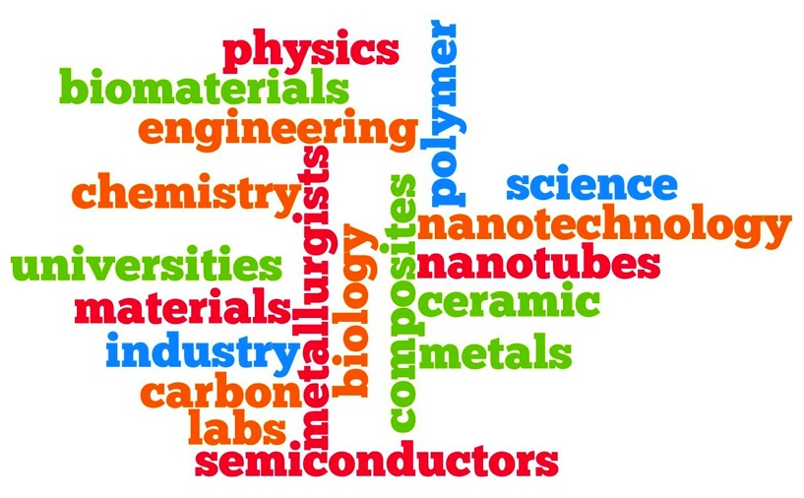
What do Materials Scientists do?
Investigate how materials are made, figure out how they can be changed and improved, and engineer entirely new materials.
Materials science is an interdisciplinary field with many applications

Slide 9
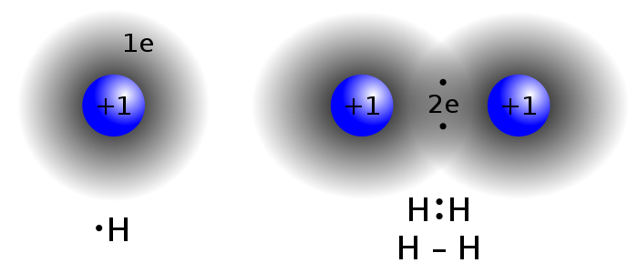
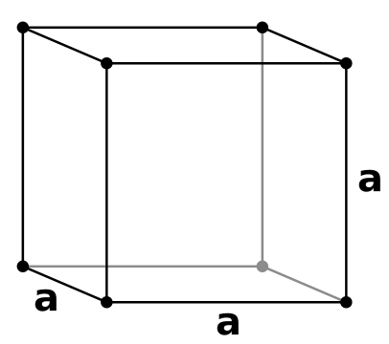
What is structure? Atomic Structure – 10⁻¹⁰ m
Pertains to electron structure and atomic arrangement
Atom length scale
Includes electron structure – atomic bonding
ionic
covalent
metallic
secondary bonding (Van der Waals)
Atomic ordering – crystal structure
Crystalline
Polycrystalline
Amorphous
Long range (metals), short range (glass)
Notes:
Covalent bonding electron sharing. Image source: public domain, 2007, Jacek FH, Wikimedia Commons, http://commons.wikimedia.org/wiki/File:Covalent_bond_hydrogen.svg
Cubic lattice unit cell (the simple cubic crystal structure). Image source: (limited use permitted) 2007 Copyright Baszoetekouw, Wikimedia Commons, http://commons.wikimedia.org/wiki/File:Lattic_simple_cubic.svg

Slide 10
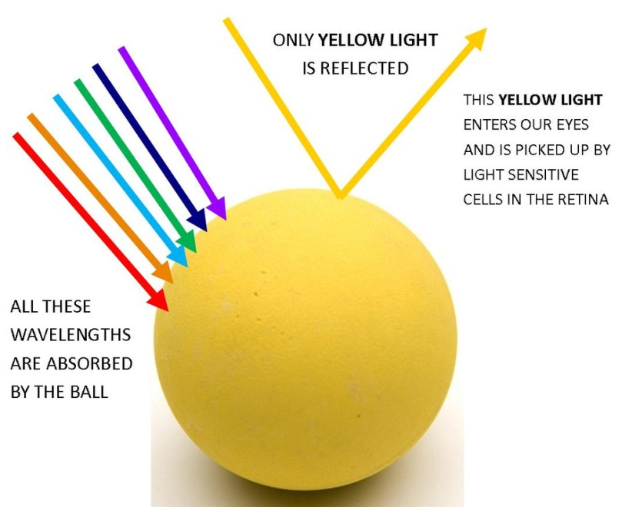
What is a property?
A material’s response to an external stimuli – physical and chemical
Electrical
Mechanical
Chemical
Optical
Magnetic
Optical: Stimuli = light [EM radiation]
https:// colour-yourlife.co.uk

Slide 11
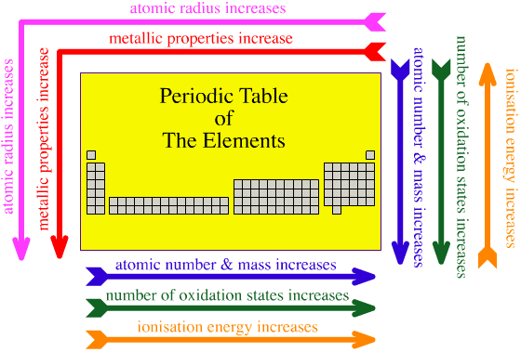
Structure/Property Relationships Atomic Structure
Periodic Table – general trends

Slide 12
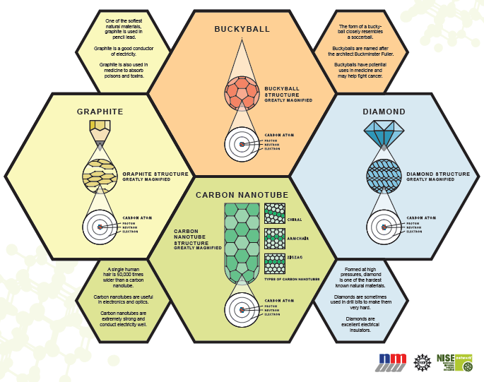
Structure/Property Relationships Crystal structure and bonding
Notes:
Assemble Buckyballs

Slide 13
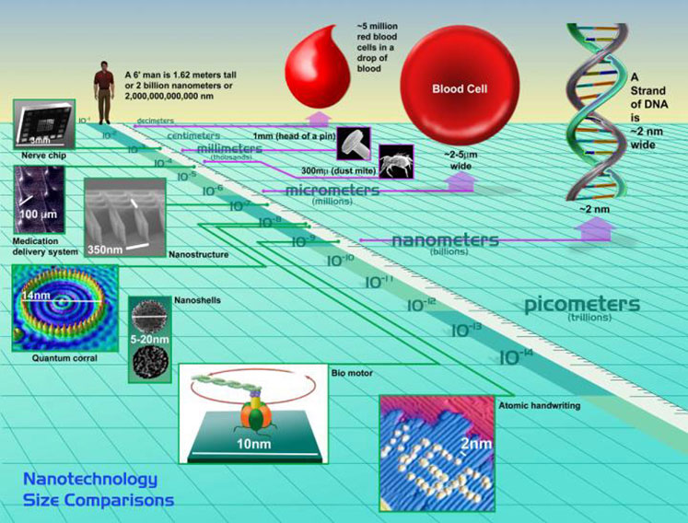
Length Scales of Materials Science
Atomic – < 10⁻¹⁰ m
Nano – 10⁻⁹ m
Micro – 10⁻⁶ m
Macro – > 10⁻³ m
Notes:
Image source: Copyright © The Institute of Production and Recording, Minneapolis, MN http://www.ipr.edu/blog/2009/01/nano-for-real/

Slide 14
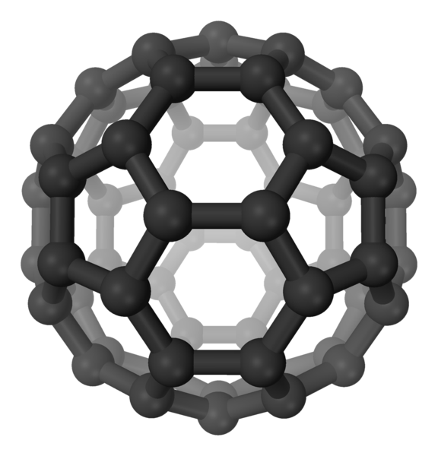
Nano Structure – 10⁻⁹ m
Length scale that pertains to clusters of atoms that make up small particles or material features
Show interesting properties because of large surface area to volume ratio
More atoms on surface compared to bulk atoms
Optical, magnetic, mechanical and electrical properties change
How to visualize nano?
Your finger nail grows ~1nm every second
Notes:
Buckminsterfullerene (“buckyball”) 3D-ball perspective
Image source: public domain, 2007, Benjah-bmm27, Wikimedia Commons, http://commons.wikimedia.org/wiki/File:Buckminsterfullerene-perspective-3D-balls.png

Slide 15
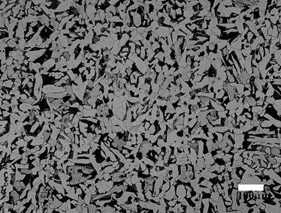
Microstructure – 10⁻⁶
Larger features composed of either nanostructured materials or periodic arrangements of atoms known as crystals
Features are visible with high magnification in light microscope.
Grains, inclusions other or micro-features that make up material
These features are traditionally altered to improve material performance
Human hair is ~100 microns in diameter
1 micron
Notes:
Z06 Black Chevrolet Corvette. Image source: public domain, Frank Williams, Wikimedia Commons, http://commons.wikimedia.org/wiki/File:Z06-Blk-7.jpg
Pearlite microstructure (low carbon steel with ferrite [white] and lemellar ferrite/cementite [black] two-phase structure. Lemellar structure is to fine to resolve at magnification. Image source: Archival microstructure without pearlite banding. A.J. Duncan, K.H. Subramanian, R.L. Sindelar, K. Miller, A.P. Reynolds and Y.J. Chao, J-Integral Fracture Toughness Testing and Correlation to the Microstructure of A285 Steel for Fracture Analysis of Storage Tanks, WSRC-MS-2000-00282, sti.srs.gov

Slide 16
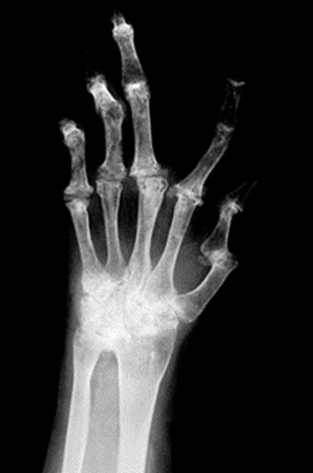
Macrostructure – 10⁻³ m
Macrostructure pertains to collective features on microstructure level
Grain flow, cracks, porosity are all examples of macrostructure features
Some features can be observed with the naked eye
Notes:
Broken fingers showing cracking as a macrostructure or feature. Image source: Brittlebone, US National Institutes of Health, http://www.nih.gov/researchmatters/january2010

Slide 17
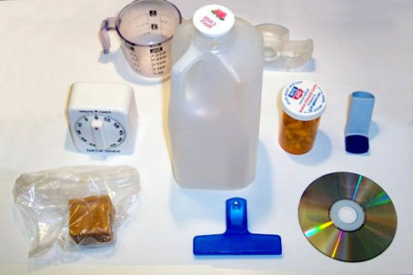
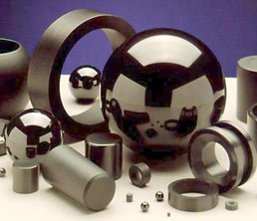
Classes of Materials
metals
polymers
ceramics/glasses
composites
Notes:
Liberty bell made of copper-based metal alloy. Image source: 2008, Tony the Misfit, Wikimedia Commons, http://commons.wikimedia.org/wiki/File:Liberty_Bell_2008.jpg
Household plastic (polymer) items. Image source: public domain, 2006, ImGz, Wikimedia Commons, http://commons.wikimedia.org/wiki/File:Plastic_household_items.jpg
Silicon nitride ceramic ball valves and ball bearings. Image source: public domain, David W. Richerson and Douglas W. Freitag, Oak Ridge National Laboratory (federal lab), http://en.wikipedia.org/wiki/File:Si3N4bearings.jpg
Plasan Sand Cat armored vehicle with composite technologies for improved ballistic protection. Composites offer high-strength, low-density alternatives to metallic armor with improved ballistics protection. Image source: public domain, 2007, Dino246, Wikimedia Commons, http://commons.wikimedia.org/wiki/File:Plasan_SandCat.jpg

Slide 18
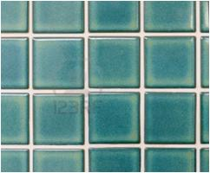
Ceramic/glass Applications
Window glass: Al₂O₃ – SiO₂ – MgO – CaO
Aerospace, energy and automotive industry
heat shield tiles
engine components
reactor vessel and furnace linings
Consumer products:
pottery
dishes (fine china, plates, bowls)
glassware (cups, mugs, etc.)
eye glass lenses
Ceramic braces

Slide 19
Other advanced materials
Semiconductors – ceramics
computer chips
memory storage devices
solar cells
image screens
Nanomaterials – ceramics, metals, polymers
gold nanoshells
quantum dots
ferrofluids
medical devices

Slide 20
How do we test materials? Materials Characterization
We use mechanical, chemical and imaging methods
Mechanical testing gives strength, ductility and toughness material information
tensile tests
bend tests
compressive tests
fracture testing
Chemical testing tells us about composition and chemical stability
x-ray diffraction and fluorescence – composition testing
corrosion testing
Microscopy is more of a way to view atomic, nano and microstructures, and gives us insight to structure property relationships
light optical microscope – microstructure
scanning electron microscope – microstructure and nano structure
transmission electron microscope – nanostucture and atomic structure
scanning probe microscope – atomic structures

Slide 21
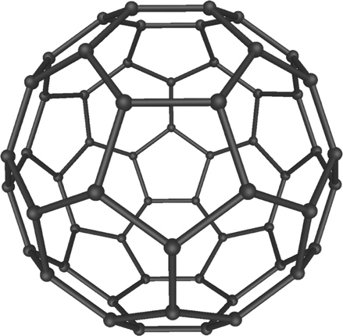
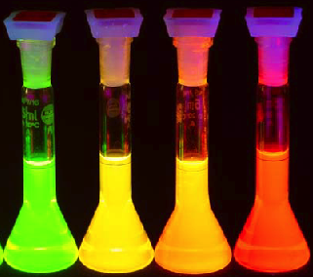
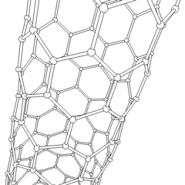
Nanotechnology
Control & manipulation of matter [1-100nm]
Unique phenomenon enable novel applications
1 nm
Quantum dots
Nanosize semiconductors
[DVD, video games]
C nanotube
cylindrical fullerene
[photovoltaic, solar cell]
C₆₀ buckyball
fullerene

Slide 22
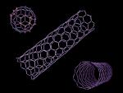
Innovations In Development or Under Investigation
Health Care
Chemical and biological sensors, drugs and delivery devices, prosthetics and biosensors
Technology
Better data storage and computation
Environment
Clean energy, clean air
Thin layers of gold are used in tiny medical devices
Carbon nanotubes can be used for H fuel storage
Possible entry point for nanomedical device

Slide 23
Examples of current commercial products
Cosmetics (skin care products)
Tennis balls which last longer
Wrinkle free fabrics, “nano-fabrics”
Sunscreen with transparent zinc-oxide
The possibilities are limitless…
Notes:
“A cotton fiber is a round cylinder. On a nano scale, it's the size of a tree trunk. Now imagine grafting lots of little hairs onto the tree trunk until it creates a peach fuzz effect. Soane is doing that to the fibers, using what he calls nano-whiskers, which are built atom-by-atom. This is all pretty tricky. The whiskers have to be the right shape. They have to be able to be suspended in water so fabric can be dipped into a nano-whisker solution. And, once applied to the fabric, the whiskers have to land on the surface and stick with the blades pointing up.
The fuzz on the fibers is permanent — it changes the fabric itself so it can't wash or wear off like other coatings used to make cotton resist wrinkles and stains. It is also undetectable, except when seen under a high-power microscope.
The fuzz creates a cushion of air around the fibers, Soane says. When water hits the fabric, it beads up on the cushion and rolls off. It can't get through. But if force is applied to the water, it passes through the fabric but doesn't get absorbed by the fibers — so sweat, for instance, can still be wicked away from your body. Apply this to a pair of khakis, and you get pants that resist wrinkles, stay dry in the rain and wipe clean when, for instance, air turbulence shimmies your coffee cup off the airline tray table and onto your lap.”
(Kevin Maney, 2002, Nanotech advances nanew fabric, USA TODAY retrieved on August 10, 2007 from http://www.usatoday.com/tech/columnist/cckev060.htm)

Slide 24
Potential Impacts
How might Materials Science, Engineering and Manufacturing enhance K-12 education?

Slide 25
For Discussion -- M&M Connections to the NAE Frameworks
Science and Engineering PRACTICES FOR K-12 SCIENCE CLASSROOMS
Asking questions (for science) and defining problems (for engineering)
Developing and using models
Planning and carrying out investigations
Analyzing and interpreting data
Using mathematics and computational thinking
Constructing explanations (for science) and designing solutions (for engineering)
Engaging in argument from evidence
Obtaining, evaluating, and communicating information

Slide 26
CORE AND COMPONENT IDEAS IN THE PHYSICAL SCIENCES
Core Idea PS1: Matter and Its Interactions
PS1.A: Structure and Properties of Matter
PS1.B: Chemical Reactions
PS1.C: Nuclear Processes
Core Idea PS2: Motion and Stability: Forces and Interactions
PS2.A: Forces and Motion
PS2.B: Types of Interactions
PS2.C: Stability and Instability in Physical Systems
Core Idea PS3: Energy
PS3.A: Definitions of Energy
PS3.B: Conservation of Energy and Energy Transfer
PS3.C: Relationship Between Energy and Forces
PS3.D: Energy in Chemical Processes and Everyday Life
Core Idea PS4: Waves and Their Applications in Technologies for Information Transfer
PS4.A: Wave Properties
PS4.B: Electromagnetic Radiation
PS4.C: Information Technologies and Instrumentation

Slide 27
Summary
Materials Science & Engineering
A branch of science that focuses on materials; interdisciplinary field composed of physical, life and engineering sciences.
Relationship of material properties to its structure, performance and processing.
Interdisciplinary field with huge potential for synergies with the National Academies Frameworks, Next Generation Science Standards & Common Core.

Slide 28
Materials, Manufacturing and the K-12 Curriculum
David Tuttle
David is the Dept. head for the Precision Manufacturing Program at Platt Technical High School which is part of the Connecticut Technical High School System in which he oversees two instructors, teaches grades 11 & 12 in advanced technologies. He also manages program budgets, purchasing, inventory, shop floor requirements, industrial relations and job placements for Platt Tech. David has many years for relevant industry experience that he will share during his sessions
Gregory AmEnde
Greg is currently entering his 4th year as a manufacturing instructor at Platt Technical High School. He previously worked for 2 years as a manufacturing instructor at Housatonic’s Advanced Manufacturing program. Before teaching Greg worked for EDAC Technologies in the Aero Rotating Components division. At EDAC he worked in multiple departments including VTL operations, Tool Room, Special Processes, Inspection, and Assembly. EDAC specializes in aerospace engine components for the military, commercial airlines, energy companies, and NASA.
Curriculum facilitator -- Yvonne Klancko
Yvonne is a partner of the consulting firm of Klancko & Klancko, LLC, specializing in the areas of education consulting, new program development, creative teaching techniques, testing and community relations.

